Slide 1
SWE-4805: Software Verification and Validation
Introduction
Md. Nazmul Haque
Lecturer, IUT
Department of Computer Science and Engineering
Islamic University of Technology
November 23, 2021

Slide 2
Contents
Contents
Relations
Functions

Slide 3
Sets and Relations
Look Back to the Previous Class
Formal method
Formal specification
Formal execution model
Sets
Product
Power set
Relations
Binary
Ternary
N-ary

Slide 4
Sets and Relations
Binary Relation
A binary relation R between A and B is an element of Pow(A x B), i.e., R ⊆ A x B
Examples:
Parent : Person x Person
Parent = { (John, Autumn), (John, Sam) }
Square : Z x N
Square = {(1,1), (-1,1), (-2,4)}
The set of first elements is the definition domain of the relation
domain(Parent) = {John} NOT Person
The set of second elements is the image of the relation
image(Square) = {1,4} NOT Ν
Exercise: How about {(1,blue),(2,blue),(1,red)}
Domain ?
Image ?

Slide 5
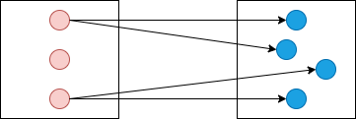
Sets and Relations
Common Relation Structures
One-to-Many

Slide 6
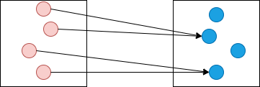
Sets and Relations
Common Relation Structures
Many-to-One

Slide 7
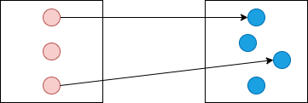
Sets and Relations
Common Relation Structures
One-to-One

Slide 8
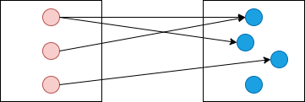
Sets and Relations
Common Relation Structures
Many-to-Many

Slide 9
Sets and Relations
Functions
A function is a relation F of arity n+1 containing no two distinct tuples with the same first n elements.
for n=1
∀ (a1,b1) ∈ F, ∀ (a2, b2) ∈ F, (a1 =a2 ⇒ b1=b2)
Which of the following are functions?
- Parent = { (John, Autumn), (John, Sam) }
- Square = {(1,1), (-1,1), (-2,4)}
- ClassGrades = { (Todd,A), (Jane,B) }
A function is a relation that is X-to-One

Slide 10
Sets and Relations
Special kinds of Functions
Consider a function f from S to T
f is total is defined for all values of S
f is partial if undefined for some values of S
Fig: Total function
Fig: Partial function

Slide 11
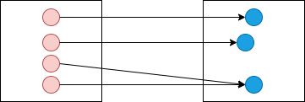
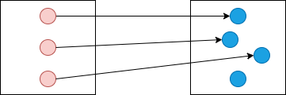
Sets and Relations
Special kinds of Functions
Consider a function f : S -> T
f is injective (one-to-one) if no image element is associated with multiple domain elements.
f is surjective (onto) if its image is T.
bijective if it is both injective and surjective.
Fig: Injective function
Fig: Surjective function

Slide 12
Sets and Relations
Relation Composition
Use two relations to produce a new one
map domain of first to image of second
Given, s: A x B and r: B x C, then
s;r = A x C
Example
s = {(red,1), (blue,2)}
r = {(1,2), (2,4), (3,6)}
s;r = {(red,2), (blue,4)}

Slide 13
Sets and Relations
Relation Closure
Intuitively, the closure of a relation r: S x S, written r+, is what you get when you keep navigating through r until you can’t go any further.
r+ ≡ r ∪ (r;r) ∪ (r;r;r) ∪ …
Example
GrandParent = = Parent;Parent
Ancestor = = Parent+

Slide 14
Sets and Relations
Relation Transpose
Intuitively, the transpose of a relation r: S x T, written ~r, is what you get when you reverse all the pairs in r.
~r ≡ {(b,a) | (a,b) ∈ r}
For example
ChildOf = = ~Parent
DescendantOf == (~Parent)+

Slide 15
ANY QUESTION ?
THANK YOU !

Slide 16
Acknowledgements
Acknowledgements
[1] Marcus S. Fisher, Software Verification and Validation: An Engineering and Scientific Approach, Springer, 2007 edition, 2006.
[2] Chauhan, Naresh. Software Testing: Principles and Practices. Oxford university press, 2010.
[3] Department of Software Engineering, University of Iowa.

